Slide 1
SKILL DEVELOPMENT CELL- SB WELCOMES 2022-2026 BATCH STUDENTS

Slide 2


Slide 3

WHAT IS SKILL DEVELOPMENT CELL

Slide 4
SKILL DEVELOPMENT CELL IS A PLATFORM WHERE YOU LEARN INDUSTRY ORIENTED COURSES FROM GLOBALLY RECOGNIZED ACADEMIES.

Slide 5

WHAT DO YOU GAIN THROUGH SDC – SKILLS

Slide 6
GRIETSDC (GRIET Skill Development Cell) is established in the year 2019 (www.grietsdc.in). Skill Development Cell has been entrusted the responsibility to train students by providing them various courses, with objective for enhancing their Employment/ Self-Employment opportunities.

Slide 7
VISION & MISSION
To create an eco-system where students can get trained in latest and up to date emerging tools and technologies.•
Facilitate cooperation between industry and academia.•
To create awareness and participation across various domains.
•To help the students attain world class standards of competence and excellence.

Slide 8
OBJECTIVES:-
Upgrade the student’s skills and make them ready for better employment.-
Assist students to explore new ideas and initiate start-ups.
Guide them to get exposed to various domains and to make innovative projects.
To meet its objectives GRIETSDC is focusing on improvement of Skills of the students on various fronts. This is done by inculcating Skill development programs among students from first year onwards. Anticipating, before they complete their graduation they will be ready with the necessary skills required by the industry.
The SDC is ever growing environment where the new concepts, technologies are added time to time with the support of the various eminent organizations and industries.

Slide 9

WHAT WE OFFER HERE IN SDC

Slide 10
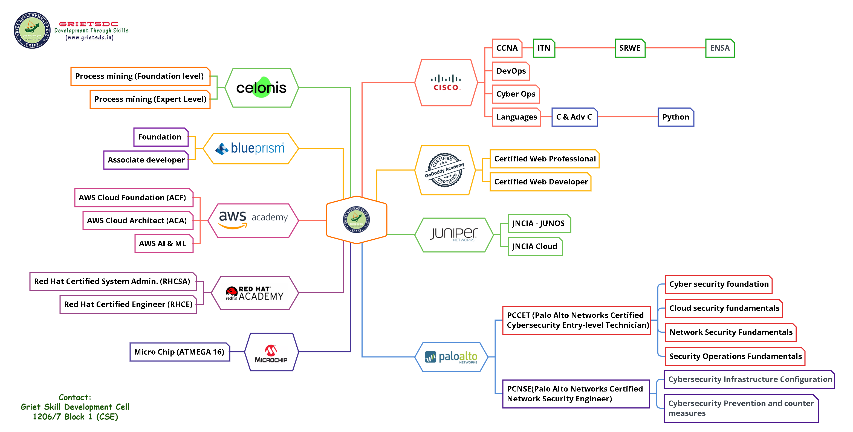

Slide 11

WHAT STUDENTS GAINED AFTER DOING THIS COURSES IN SDC???

Slide 12
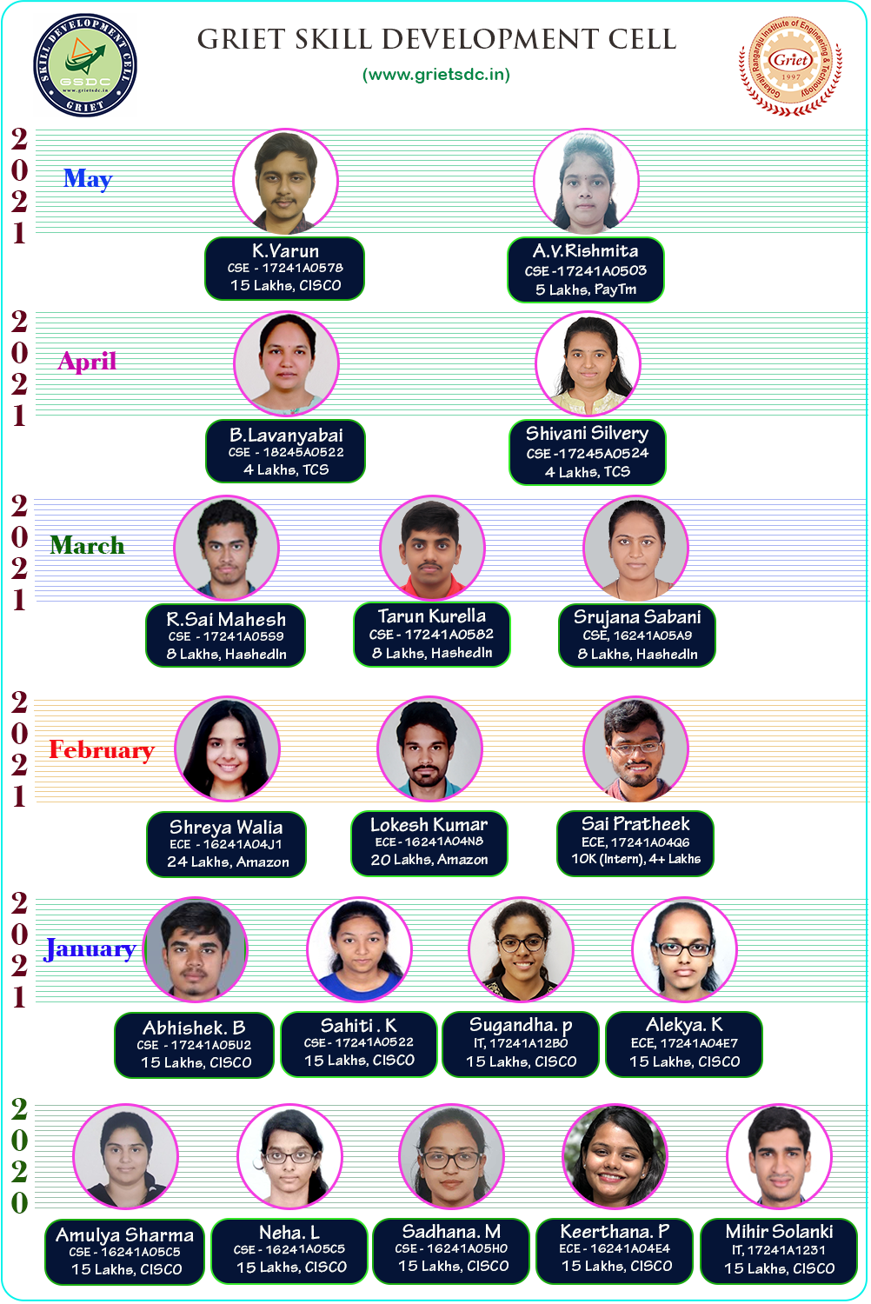

Slide 13
WE OFFER (SUMMER & WINTER) AICTE INTERNSHIPS FOR ALL THE STUDENTS IN ALL SEMESTERS

Slide 14
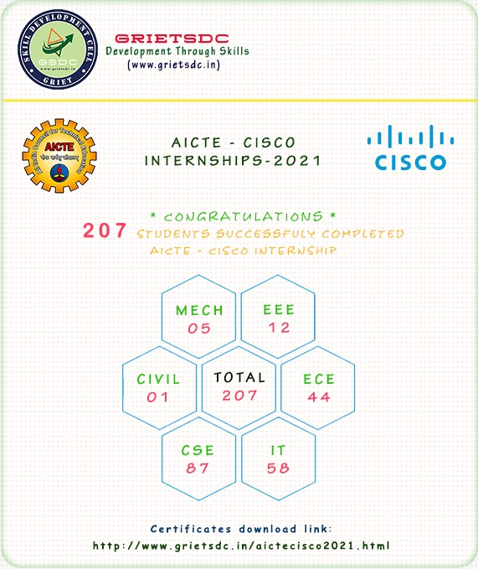

Slide 15
HOW TO JOIN IN SDC

Slide 16
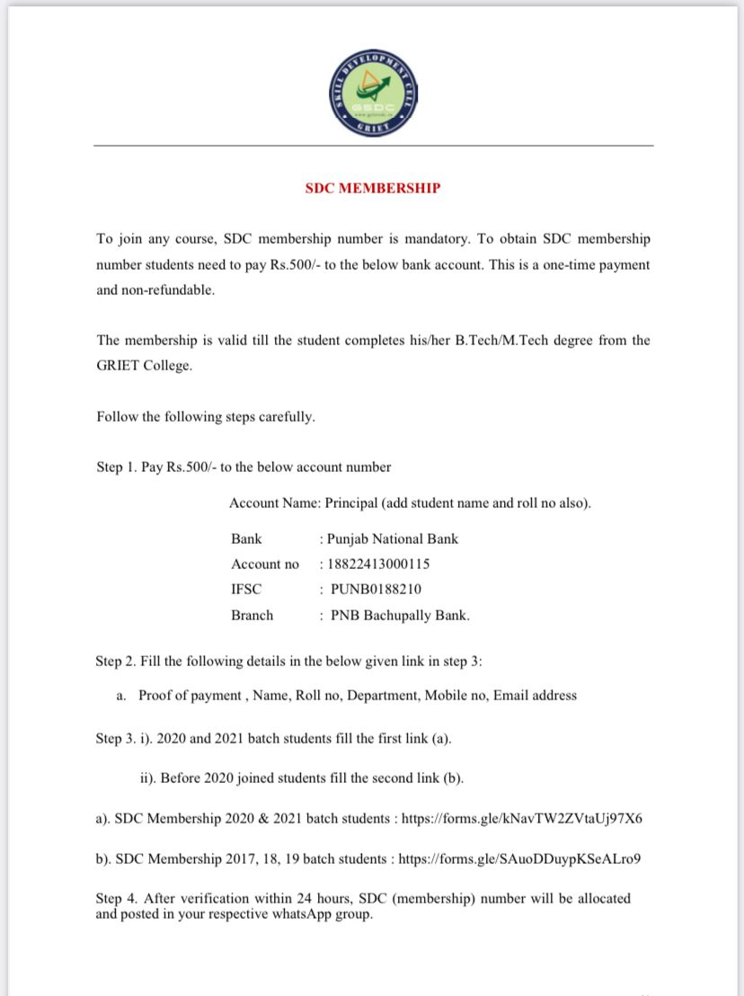

Slide 17
THIS IS OUR WEBSITE LINK
https://www.grietsdc.in/

Slide 18
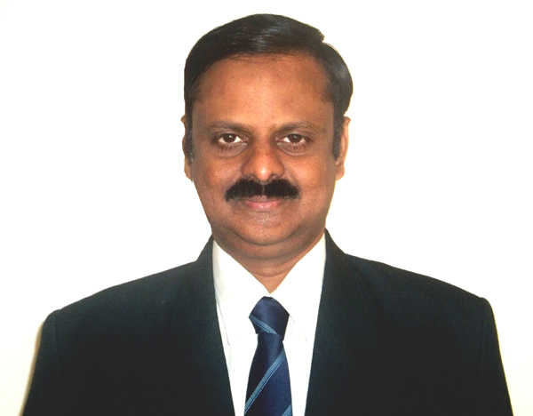
CHIEF INSTRUCTOR
Dr. G.S. Bapi Raju
M.Tech (CSE), M.Sc. (Nuclear Physics), Ph.D., MBA (HR & FIN), IDCPA (NCC, UK), MCSE, CCNA, AWS, PCCET
Professor, Department of CSE,
1206/7, CSE Block.

Slide 19
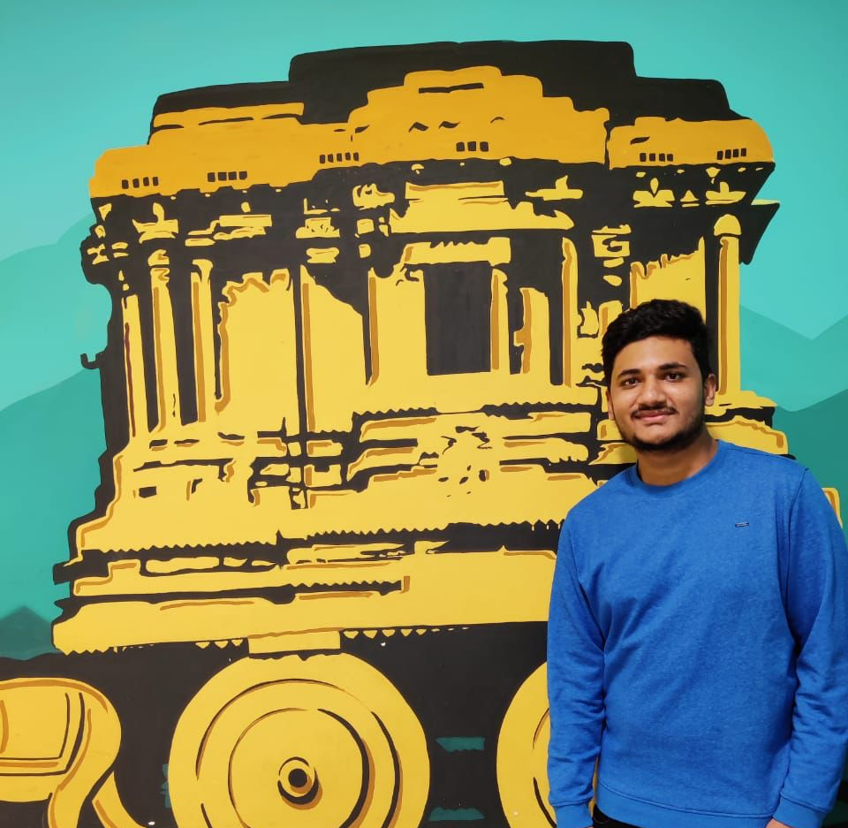
JILLELLA CHARAN TEJA REDDY WORKING PRESIDENT GRIET SKILL DEVELOPMENT CELL Contact No:- 9121369394

Slide 20
O. KAUSHIK REDDY EXECUTIVE PRESIDENT GRIET SKILL DEVELOPMENT CELL

Slide 21


